Slide 1

Microarray DEG bioinformatics pipeline using R Programming
Assoc Prof Dr Sarinder Kaur
Computer Science & Bioinformatics Laboratort
Universiti Malaya
sarinder@um.edu.my

Slide 2
Microrray Data
Download microarray datasets for GDS2519 and GDS3128 from Gene Expression Omnibus (GEO). These datasets are based on the platform of Affymetrix Human Gene 1.0 ST Array.
The dataset GDS3128 contains data for lateral and medial region in substantia nigra (SN) from post-mortem brain samples obtained from 47 individuals with sporadic Parkinson's disease (PD) and healthy controls.
The dataset GDS2519 contains whole blood data of 50 patients predominantly with early-stage Parkinson’s disease and 22 healthy controls [3].

Slide 3
Data Preprocessing
Import the original CEL data into R and use the Affy package for background correction and normalization.
After the microarray data normalizing and standardization, identify the list of differentially expressed genes (DEGs) between GDS2519 and healthy controls and GDS3128 and healthy controls, respectively using Limma from R.
Select P values < 0.05 and log₂fold change >1.0 as cut-off standards for GDS3128 and P values < 0.05 and log₂fold change >0.5 as cut-off standard for GDS2519.
DEGs that are common to these two datasets at these cut-offs are identified.

Slide 4
R Codes
https://github.com/sarinderkaur/microarray

Slide 5
Construct a Volcano plot
# Construct volcano plot
# Summarize test results as "up", "down" or "not expressed"
dT <- decideTests(fit2, adjust.method = "fdr", p.value = 0.05)
# List contrast names
colnames(fit2)
# Choose contrast of interest
ct <- 1
volcanoplot(fit2, coef = ct, main = colnames(fit2)[ct], pch = 20,
highlight = length(which(dT[,ct]!= 0)),
names = rep('.', nrow(fit2)))

Slide 6
Results
The top 10 upregulated and downregulated genes in brain and blood are listed in Table 1 and Table 2.

Slide 7
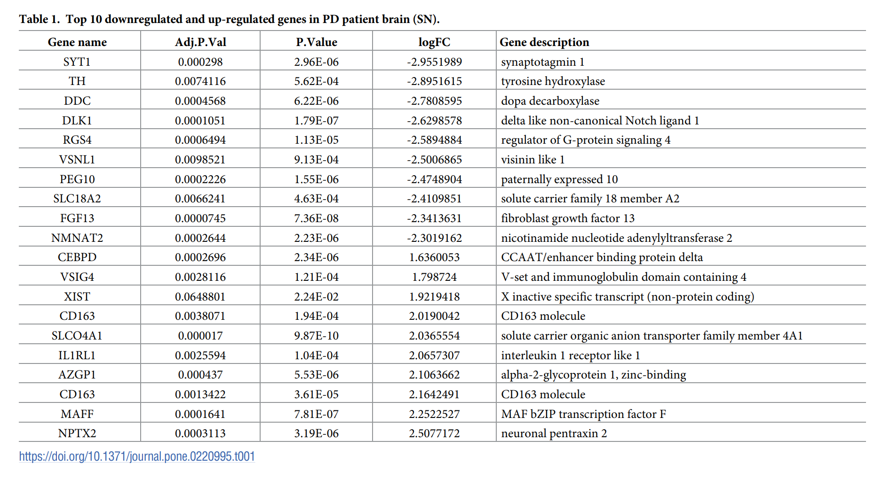
Table 1

Slide 8
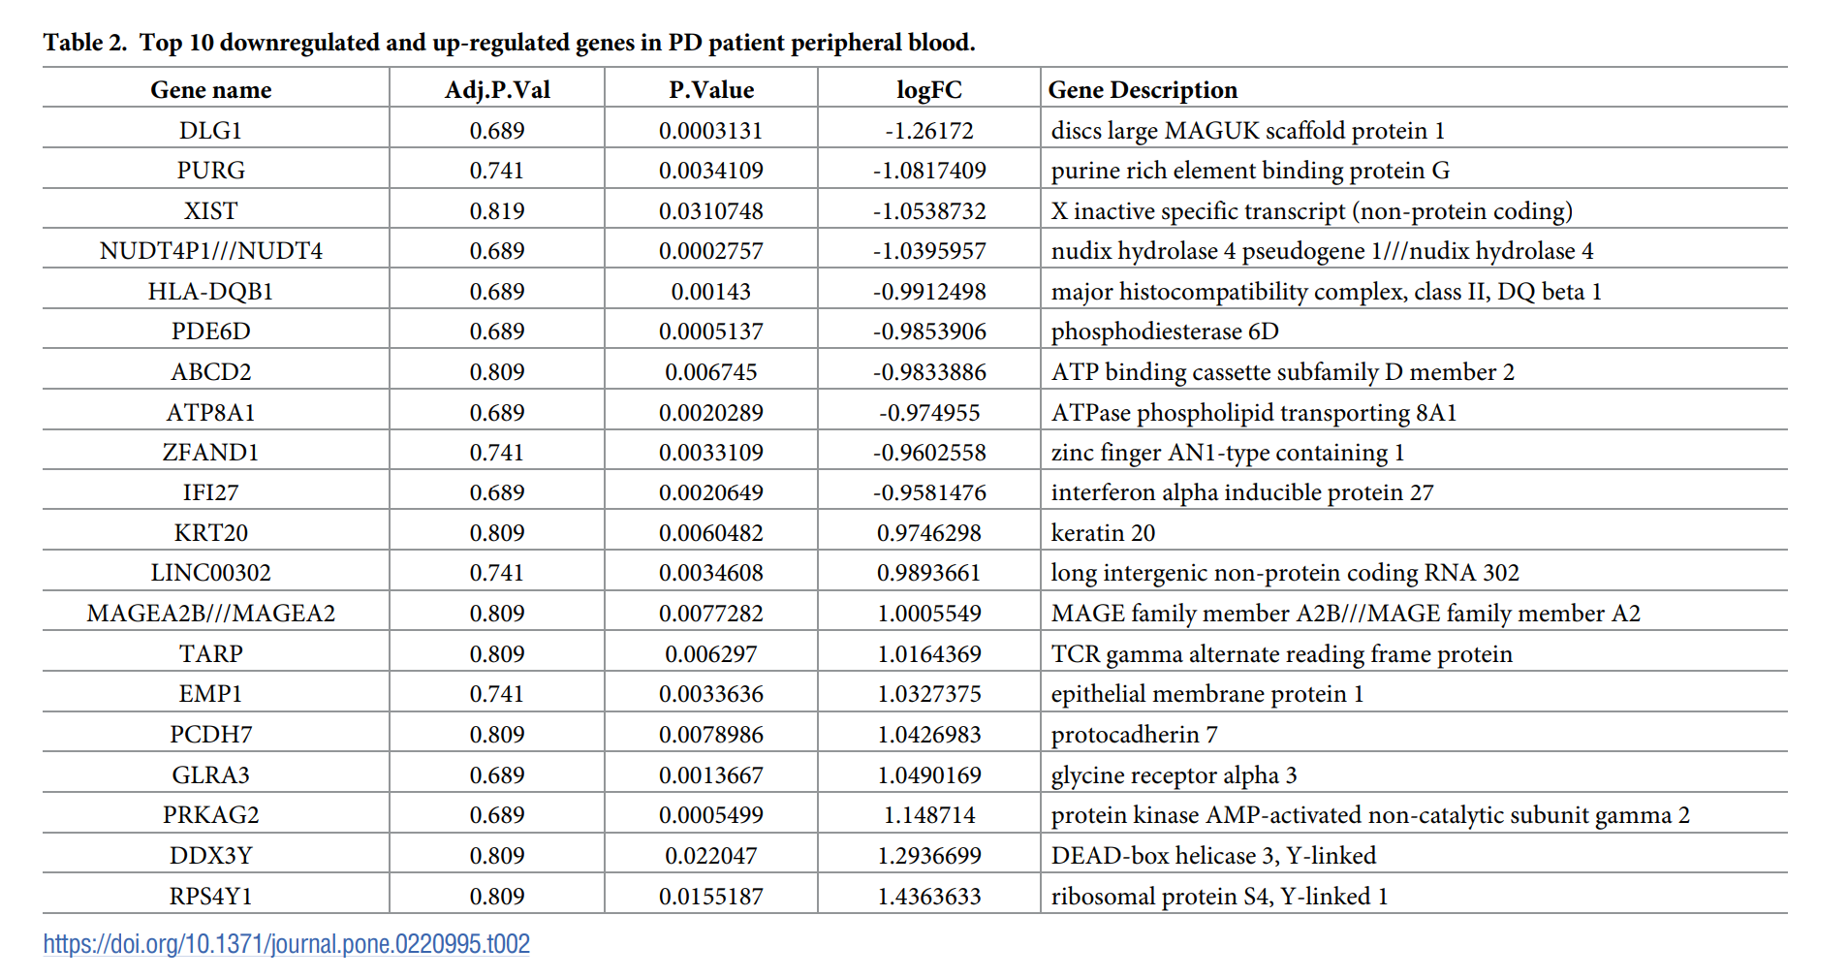
Table 2

Slide 9
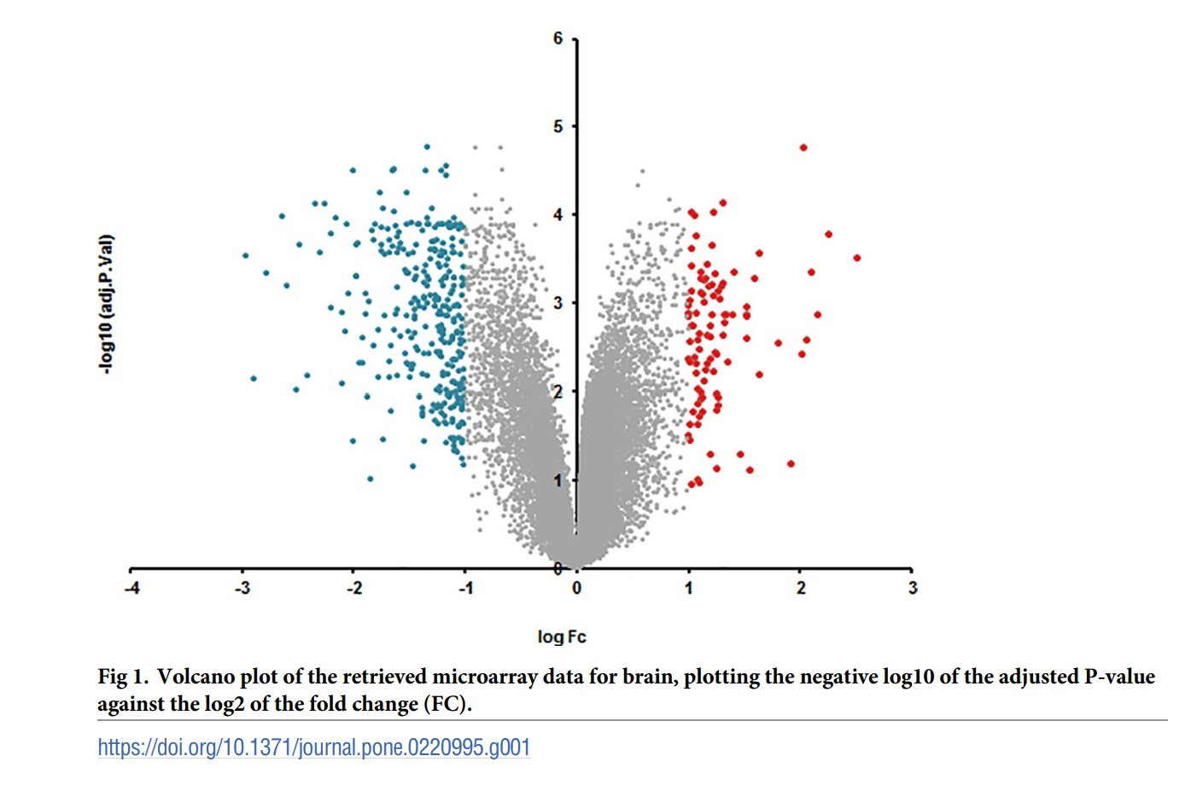
Results - Volcano Plot

Slide 10
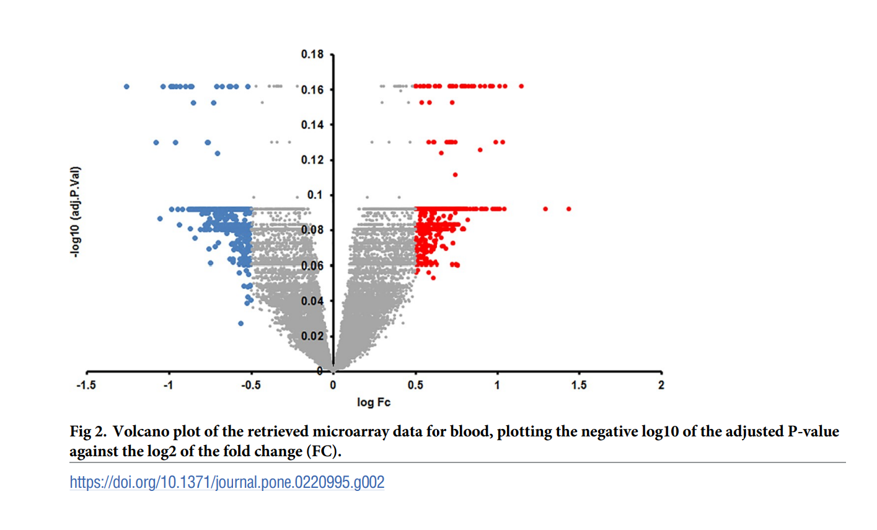
Results – Volcano Plot

